Slide 1
ADA DATASET
Saffian Asghar
Emilio Espinosa Sanchez

Slide 2
WORKFLOW
EDA
Analyze the data, filter significant attributes, substitute missing values
NORMALIZE DATA
Scale the data
MODEL
Select and build suitable models depending upon your data
COMPARISON AND ATTRIBUTES SELECTION
Train your model and test it with an unseen sample.
Compare different models results and accuracy

Slide 3
EDA
Train data
Valid data
4147 | 48
415 | 48
Train label
Valid label
4147 | 1
4147 | 1

Slide 4
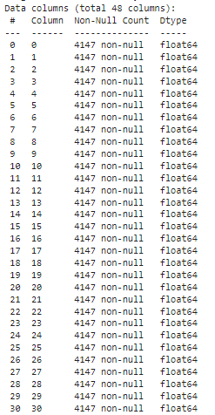
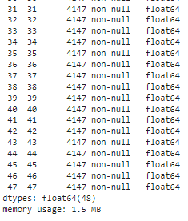
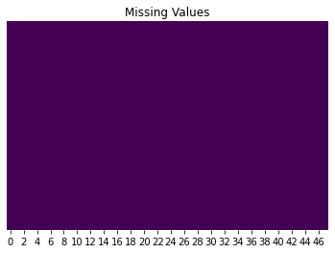
EDA

Slide 5

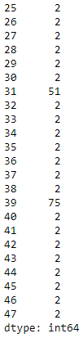
EDA
Variables
Columns: 3, 9, 14, 24, 31 and 39 contain more than 2 different values.
Columns: 13 and 20 contain only 0’s.
Rest of columns: binary (0’s and 1’s)

Slide 6
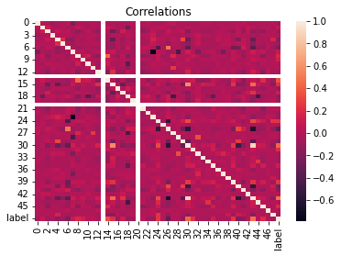
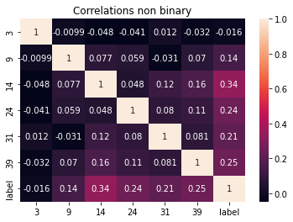
EDA-CORRELATIONS
Therefore we dropped columns 13 and 20.
Not significant correlations with label (y).

Slide 7
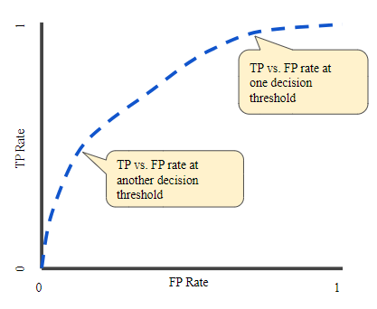


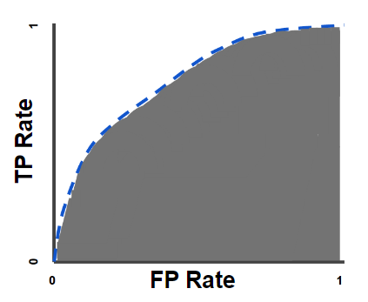
AUC - ROC Curve
An ROC curve (receiver operating characteristic curve) is a graph showing the performance of a classification model at all classification thresholds. This curve plots two parameters:
True Positive Rate
False Positive Rate

Slide 8
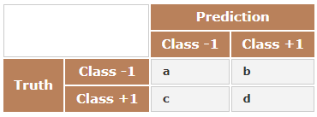
Balanced Error Rate
BER is the average of the proportion of wrong classifications in each class
BER is used to determine the winner in the unlikely case that two (or more) contestants have obtained an equal accuracy

Slide 9
KNN

Slide 10
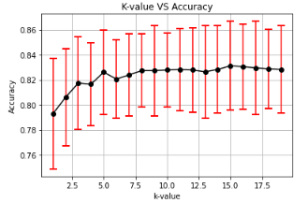
KNN
CV: 50 folds
K = 8 has less error.
Notes:
# Accuracy: how good we were in recognizing positive and negative
# Precision: how correct the classifier is
# Recall: how complete the classifier is
# F-Score: combination of presition and recall

Slide 11

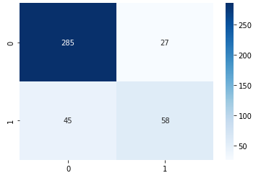
KNN
CV: 50 folds
Notes:
# Accuracy: how good we were in recognizing positive and negative
# Precision: how correct the classifier is
# Recall: how complete the classifier is
# F-Score: combination of presition and recall

Slide 12
Linear Discriminant Analysis

Slide 13

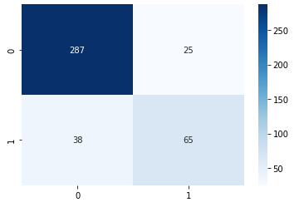
LDA
CV: 50 folds
Notes:
# Accuracy: how good we were in recognizing positive and negative
# Precision: how correct the classifier is
# Recall: how complete the classifier is
# F-Score: combination of presition and recall

Slide 14
Logistic Regression

Slide 15
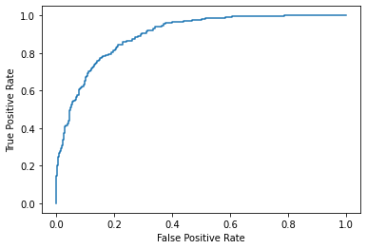


Logistic Regression ROC Curve
CV: 50 folds
Notes:
# Accuracy: how good we were in recognizing positive and negative
# Precision: how correct the classifier is
# Recall: how complete the classifier is
# F-Score: combination of presition and recall

Slide 16
Naive Bayes

Slide 17


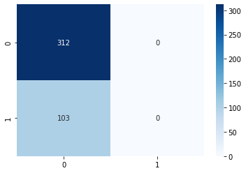
Gaussian Naive Bayes
CV: 50 folds
GNB Mean Accuracy: 0.683
GNB BER in validation set: 0.5
GNB AUC in validation set: 0.5
GNB confidence intervals: 0.669 0.697
Notes:
# Accuracy: how good we were in recognizing positive and negative
# Precision: how correct the classifier is
# Recall: how complete the classifier is
# F-Score: combination of presition and recall

Slide 18
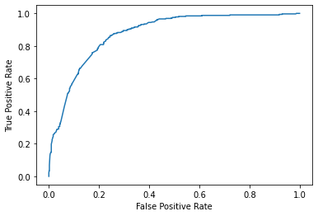

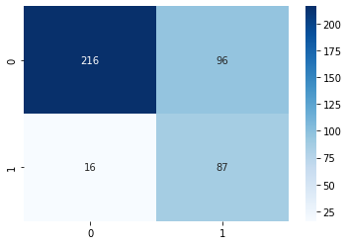
Bernoulli Naive Bayes
CV: 50 folds
BNB Mean Accuracy: 0.768
BNB BER in validation set: 0.232
BNB AUC in validation set: 0.768
BNB confidence intervals: 0.754 0.783
Notes:
# Accuracy: how good we were in recognizing positive and negative
# Precision: how correct the classifier is
# Recall: how complete the classifier is
# F-Score: combination of presition and recall

Slide 19
Decision Tree

Slide 20

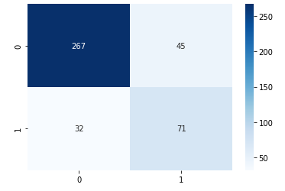
Decision Tree
CV: 50 folds
Notes:
# Accuracy: how good we were in recognizing positive and negative
# Precision: how correct the classifier is
# Recall: how complete the classifier is
# F-Score: combination of presition and recall

Slide 21
Model Comparison

Slide 22
Comparison Table
PARAMETER | KNN | LDA | LOG. REG. | NAIVE BAYES GNB | NAIVE bAYES BNB | DECISION TREE
ACCURACY | 0.827 | 0.843 | 0.848 | 0.683 | 0.768 | 0.80
BER | 0.262 | 0.225 | 0.226 | 0.5 | 0.232 | 0.227
AUC | 0.738 | 0.775 | 0.774 | 0.5 | 0.768 | 0.773
CONFIDENCE INTERVALS | 0.819 < X < 0.836 | 0.832 < X < 0.854 | 0.838 < X < 0.859 | 0.669 < X < 0.697 | 0.754 < X < 0.783 | 0.787 < X < 0.813
Notes:
# Accuracy: how good we were in recognizing positive and negative
# Precision: how correct the classifier is
# Recall: how complete the classifier is
# F-Score: combination of presition and recall

Slide 23
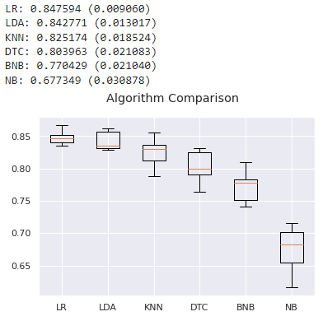
Run again with cv = 10

Slide 24
THANK YOU
Saffian
Emilio

